Slide 1

Projeto Interdisciplinar
Paulo Alceu Rezende

Slide 2
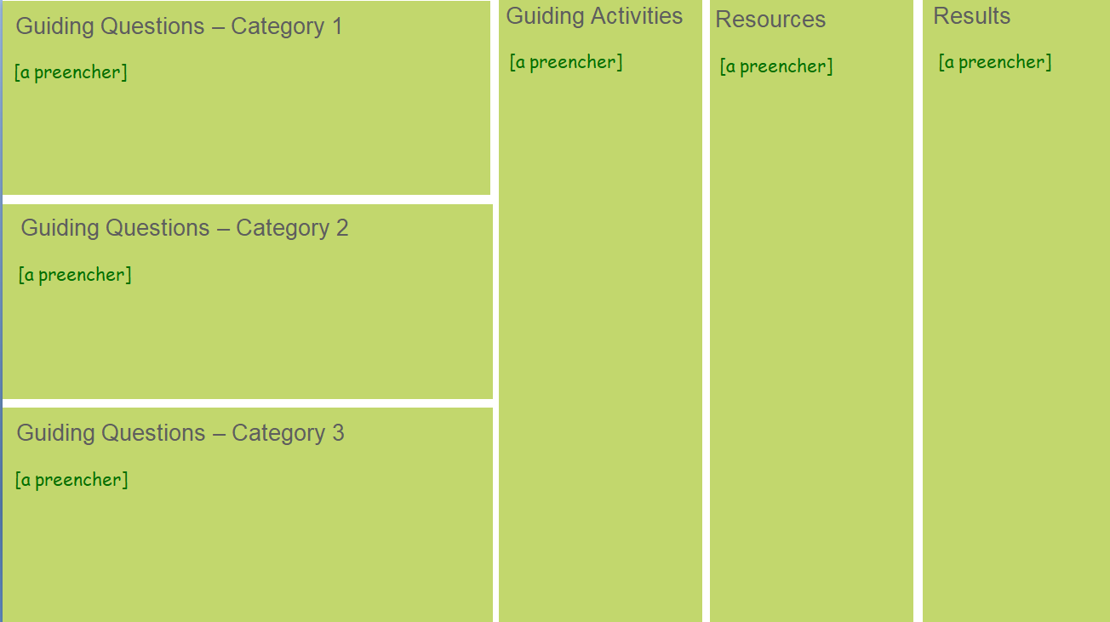
Engage
Strength
Weaknesses
Big idea
Essential Question
Forças
Challenge
Investigate
Problems/Opportunities
Main Benchmark
Critical success factors
Design Patterns
Stakeholders
Act - Requirements' Identification
Act - Development approach
Value proposition
Platform/
Technologies
Prototype Test Strategy
Indicators
Test Strategy
Design Patterns
Requirements
Requirements
Design rules
Coding rules
Refinement Strategy

Slide 3
Strength
Weaknesses
Big idea
Engage
Equipe
Planejamento Orçamentário
Reserva de Emergência
Análise de Despesas
Investimentos Planejados
Controle de Dívidas
Falta de Planejamento
Ausência de Reserva de Emergência
Gastos Impulsivos
Não Definir Metas
Criar um aplicativo que ajude usuários a gerenciar suas finanças pessoais de forma eficaz, incluindo controle de orçamento, despesas, metas financeiras e geração de relatórios.
Essential Question
[a preencher]
Challenge
[a preencher]

Slide 4
Guiding Questions – Category 1
Guiding Activities
Resources
Results
[a preencher]
[a preencher]
[a preencher]
[a preencher]

Slide 5
Guiding Questions – Category 2
Guiding Activities
Resources
Results
[a preencher]
[a preencher]
[a preencher]
[a preencher]

Slide 6
Guiding Questions – Category 3
Guiding Activities
Resources
Results
[a preencher]
[a preencher]
[a preencher]
[a preencher]

Slide 7
Guiding Questions – Category 4
Guiding Activities
Resources
Results
[a preencher]
[a preencher]
[a preencher]
[a preencher]

Slide 8
Guiding Questions – Category 5
Guiding Activities
Resources
Results
[a preencher]
[a preencher]
[a preencher]
[a preencher]

Slide 9
Guiding Questions – Category 6
Guiding Activities
Resources
Results
[a preencher]
[a preencher]
[a preencher]
[a preencher]

Slide 10
Problems/Opportunities
Main Benchmark
[a preencher]
[a preencher]
Critical success factors
[a preencher]
Stakeholders
[a preencher]

Slide 11
Value Proposition
Platform/Technologies
Prototype Test Strategy
[a preencher]
[a preencher]
[a preencher]
Design rules
Requirements
[a preencher]
[a preencher]

Slide 12
Indicators
Test Strategy
Design Patterns
[a preencher]
[a preencher]
[a preencher]
Development rules
Refinement Strategy
[a preencher]
[a preencher]

